Slide 1
FVA is an Italian SME operating since 1990 in the field of new media communication and advanced ICT for research and organizations contexts.
Company profile

Slide 2
Strategic Dissemination and Communication to promote science
Training, co-creation workshops and focus groups with stakeholders
Media and New Media production
Social media strategies and ICT solutions (Applications, Widgets, Animated Commercials, E-games)
Serious games, advergames and entertainment
Technology Enhanced training platforms
ICT solutions, Graphic design, 3D modelling and animation,HCI and interface design
What we do

Slide 3
Bioeconomy
Learning
Health
SSH Social Sciences and Humanities
Social innovation and security
Domains
Together with a deep technical expertise FVA can provide to projects a strong internal experience in psychology, creativity and learning and a deep knowledge on proposal writing and management of EC research projects.

Slide 4
Supporting co-creation and mutual learning
FVA is participating to several CSA research projects (BIOWAYS, BIOVoices and DANDELION) dealing with promotion of research EC funded results.
We promote stakeholders engagement in co-creation processes
Facilitate Quadruple Helix stakeholders workshops and focus groups to define strategies to increase impact of research in society.
Focus on
In addition, FVA is partner of some Erasmus+ projects, leveraging stakeholders from different domain in a proactive dialogue addressing societal challenges (training, health, security).

Slide 5
Communication, Dissemination and Impact
FVA has nearly 25 years of experience in the advertising, communication and promotion domain.
FVA supported promotional and
communication initiatives for:
Coca-cola, Honeywell, P&G, Philips and other, directly or in cooperation with some of the most relevant PR and communication agencies like Cohn and Wolfe, Ketchum, Young & Rubicam, McCann-Erickson, Saatchi & Saatchi.
Focus on
Specifically FVA is specialized in the design and implementation of ICT and new media solutions for advertising and communication. FVA has also a long expertise in the design and promotion of social media communities.
In the research projects Leila (SEP 2012-210077817), Meal (LLP 543535 – 2013), Help for Mood (ICT-2009.5.1: Personal Health Systems, 248765), L4S – Learning for Security (IST- 225634), BALANCE (527850-LLP-1-2012-1-DE-GRUNDTVIG-GMP), FVA was responsible for the dissemination and communication WP.

Slide 6
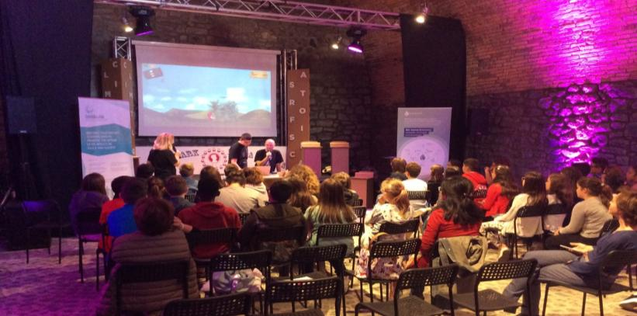
Games and gamified solutions for learning
FVA has an extensive experience in games for advertising, promotion and communication purposes.
Since early ’90 FVA believed in the power of game-based approach to involve and motivate the users, not just targeting young generations, but also adults and Businesses.
FVA designed the concept and developed several games, advergames, edutainment games and gamification solutions.
In the last years FVA is developing serious games for research and innovation projects, mainly in the bioeconomy, SSH, security, health and social innovation domains.
FVA bring to the projects 25 years of experience in game design and a 15 years experience in serious games design.
Focus on
Partial list of clients: Aereoporti di Roma, Artime, Bosch, Citroen, Cattolica University, Coca-Cola, Enel, FIGC (Federazione Italiana Giuoco Calcio), Honeywell - Hometronic, HP, INA-Assitalia, Invicta watches, IOL Italia on line, Leitz, Ketchum PR, Monte dei Paschi di Siena, Panasonic, Philips Shave, Procter & Gamble, Renault, Roche, Sector Sport Watches, SMA, Valtur, Vorwerk Folletto, Winnerland-Digibrands, Young & Rubicam.

Slide 7
FVA has also a strong experience in developing ICT based solutions for marketing, advertising and communication and game-based training platforms for organizational contexts
ABI Italian Bank Association, ACB, Acotel, Aereoporti di Roma, Artime, Bosch, Bulgari, Burson Marsteller, Bye Italy, "I Granai" mall, Citroen, Cattolica University, Coca-Cola, DLink, Enel, Fashion Group, FIGC ( Federazione Italiana Giuoco Calcio), Focus, Gai Mattiolo, Honeywell - Hometronic, HP, INA-Assitalia, INSEAD, Invicta watches, Interfree, Intertel Services, IOL Italia on line, Leitz, Japan Pearl Exporters' Association, Ketchum PR, Maximarketing, Mecal, Monte dei Paschi di Siena, Montepaschivita, Nielsen//NetRatings, Omnitel, Outgoing travel, Panasonic, Philips Shave, Procter & Gamble, Pirelli, Lombardia National Guard, Messina National guard, Procter & Gamble, Renault, Roche, Sector Sport Watches, SIA-SSB –Società Italiana per l’automazione, Syngenta, SMA, Sound PR, Spa'deus, Telital, Trento University, Unioncamere, Valtur, Valtur Casa, Vivendi group, Vorwerk Folletto, Wind, Winnerland-Digibrands, WL Gore and Associates (Goretex), Young & Rubicam.
Clients

Slide 8
Key Persons
LOUIS FERRINI - Managing director
Louis Ferrini established FVA in 1989 as one of the first multimedia companies in Italy. He gets the first level degree in graphic design and advertising in IED, Rome Italy. Then he completes a master of computer graphic at IED, Rome, Italy. Before starting his own business, he worked for several advertising and graphic companies in Italy and US. Louis Ferrini has been selected by the European Commission as evaluator for Horizon 2020.
Actually he is ICT project leader (software architecture, 3D modeling and animation, and new-tech solutions).
SUSANNA ALBERTINI - Partner
FVA New Media Design partner from 1995, she has integrated her specialization in Psychology of work and business organization with multimedia and new technology communication. Since 2000 she is involved as project manager and researcher in projects funded by the European Commission as expert in game-based training, co-creation and creativity enabling factors, communication, impact and valorization of research results.
She has been selected by the European Commission as evaluator for Horizon 2020. Her main area of interest is societal challenges with special focus on sustainable and inclusive growth.
MICHELA COHEN - Junior Project Manager
Gets his degree at University of Rome "La Sapienza" Bachelor degree in Sciences and psychological techniques of evaluation in childhood, adolescence and family (Thesis Subject: Intellectual Disability), Scholarship for thesis abroad about Early intervention in Down’s syndrome Scholarship for Erasmus mobility - Exchange Semester University of Malta, Master's degree in Clinical Psychology of the person , organizations and the community University of Rome "La Sapienza" Thesis subject: Early intervention in Down’s syndrome, A.T. Beck Institute Attendance at "Dialectical Behaviour Therapy (DBT)" seminary, University of Haifa – Ulpan Etzion, Intensive Hebrew learning program.

Slide 9
FVA main research interests are:
HCI and Interface Design, focusing on the combination of the latest technological innovation with the user needs to design usable and effective interfaces
solutions to support the technology enhanced learning experience, like system and platforms for collaborative knowledge, game-based learning and innovative training supporting tools
promotional actions to be used from the consortium to increase the impact of research results.
In several projects FVA has lead dissemination activities and actually is involved in coordinated actions to support promotion of co-funded research projects.
In addition, the humanistic background of one of the partners givies the chance to FVA to play the role of a “bridge” between the theoretical and the technical tasks of the projects.
Research Projects

Slide 10
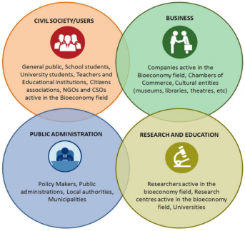
BIOVOICES (H2020-BBI-PPP-2015 - CSA 720762): BIOVoices overall aim is ensure the engagement of all relevant stakeholder groups and tackle BIO-based related challenges by establishing a multi-stakeholder platform, involving a plurality of actors (voices) with different perspectives, knowledge and experiences, and animating open dialogue and Mutual Learning between the different stakeholders.
FVA role in the project:
In the project FVA leads the activities related to the creation of the on line BIOVoices social platform and on line mutual learning activities and actively participate to the other workpackages.
FVA is also responsible for the production of promotional videos in (interviews with stakeholders, promo video of the events, etc.).

Slide 11
Ladies First! (Erasmus+ 2017-1-EL01-KA202-036219): aims to empower teachers, trainers and counselors to facilitate and empower women beneficiaries in order to gain the necessary stability in-between working and personal life, especially in the framework of crisis.

Slide 12
BIOWAYS (H2020-BBI-PPP-2015 - CSA 720762): to promote among citizens the socio-economic and environmental benefits of bio-based products and applications, seeking to enhance the societal confidence on bio-based products and industries.
FVA is leading the workpackage that develops the project communication Framework.
FVA is also responsible for the production of the training tools: Interactive games or Gamified solutions for learning, Educational videos production, Educational Multimedia Presentations.

Slide 13
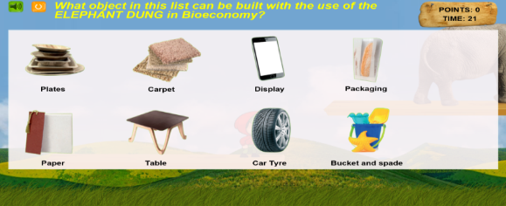
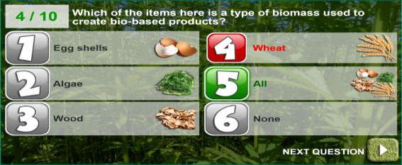
Games for Bioways
Teach bio-economy to children
A “super Mario” game to learn how raw materials can become an everyday product.
Teach bio-economy to adults
To address bio-economy terminological gaps and misunderstanding through a quiz

Slide 14
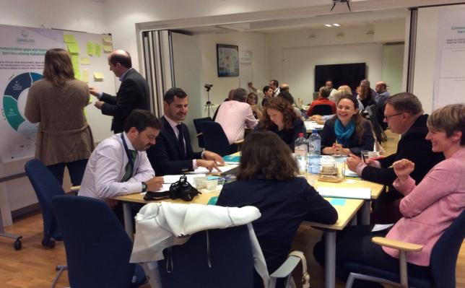
DANDELION (H2020-REFLECTIVE-SOCIETY-2015 - CSA 693796): The project aims to support the uptake and valorisation of Inclusive, Innovative and Reflective Societies (IIRS) research and improve its dissemination towards citizens, policy makers, academia and media. This will be achieved through a series of innovative and creative communication activities targeted at a range of audiences.
FVA is leading the workpackage “Fostering dialogue cooperation among key socio-economic stakeholders”, leads the design and implementation of the project’s games and participates actively in Dissemination and Communication activities, organizing and facilitating workshops and events that will take place in Italy.

Slide 15
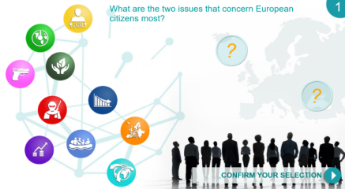
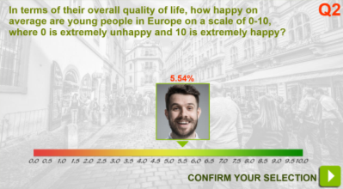
Games for Dandelion
SSH domain - Games on the European societal challenges in Europe
Gamified quiz to raise awareness and stimulate the discussion about the main societal challenges for Europeans

Slide 16
INTERHEALTH (Erasmus+ 2016-1-EL01- KA202-023538): The aim of the project is to increase the intercultural competences of healthcare professionals in Europe, through non-formal training. This project has been funded with support from the European Union.
InterHealth is expected to have a multiple impact in time, place and persons.

Slide 17
THRIVE (Erasmus+ 2015-1-EL01- KA201-013917): To reinforce the professional development of teachers of students up to 7 years old, in order to effectively promote positive behaviors in classroom as well as future school attendance and achievement.

Slide 18
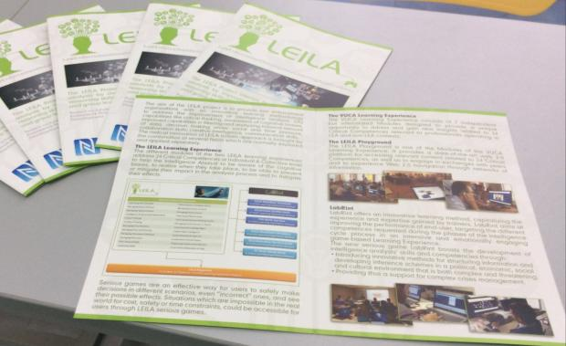
LEILA (FP7-SEC-2013-1- 608303): to provide law enforcement organizations with an innovative learning methodology and a set of serious games, to improve their cognitive capabilities, reasoning skills and creative approach to decision making, at individual and group level.
FVA is responsible of serious games design and implementation.
Specifically, the LEILA learning framework addresses the enhancement on knowledge and skills identified as crucial for IA, such as:
awareness of cognitive biases;
practice of critical thinking;
filtering and analyzing massive amount of data;
capability to draw relevant conclusions and take appropriate decisions;
decision making under social and time pressure;
creative intelligence;
collaboration capabilities and team-based decision making;
reporting and communication skills.

Slide 19
MEAL (LLP 543535 – 2013): to develop a pedagogical tool aimed at helping teachers and nutritionists (students and professionals) to acquire, train, promote and deliver basic Nutritional Education (NE) and healthy eating behavior competencies to children.
MEAL approaches eating behaviors not only in nutritional literacy sense, but also using ICT elements such as “Serious Games” platforms to consolidate the nutritional competencies and habits through an engaging experience for the children.
FVA is in charge of edutainment games design and implementation.

Slide 20
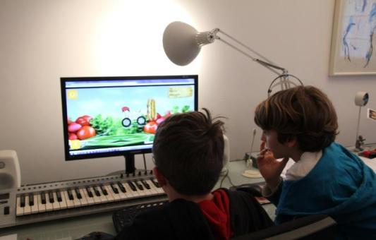
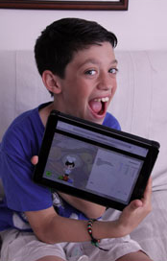
Games for MEAL
MEAL games: Modifying eating attitudes and actions through learning
To consolidate the nutritional habits through an engaging experience for the children

Slide 21
UPDESIGN (Erasmus+ 2014-1-UK01-KA204-000085): Employability and transversal skills delivery for young disadvantaged learners through innovative upcycling methods and approaches. FVA is responsible for the development of the social platform.

Slide 22
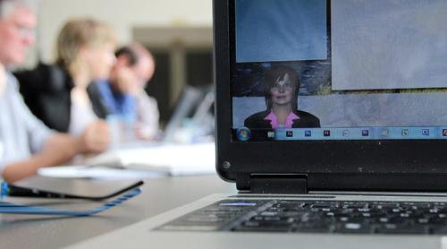
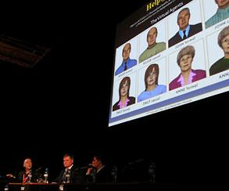
HELP4MOOD (ICT-2009.5.1 248765): Virtual agents and innovative interfaces to assist depressed people at home. FVA is responsible for the interface design, the agent visualization technology, the dissemination material design and the media production.

Slide 23
BALANCE (527850-LLP-1-2012-1-DE-GRUNDTVIG-GMP). Learning experiences to improve wellbeing for trainers and teachers.
FVA is responsible for the design of the e-learning package and the project’s dissemination material.

Slide 24
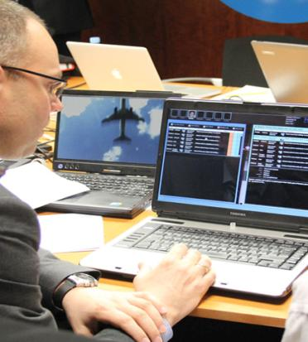
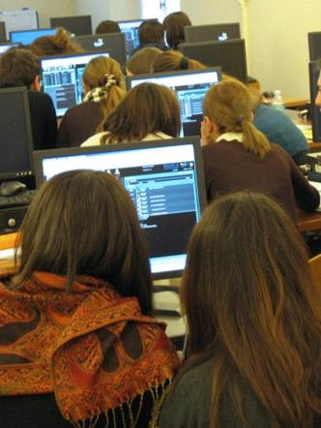
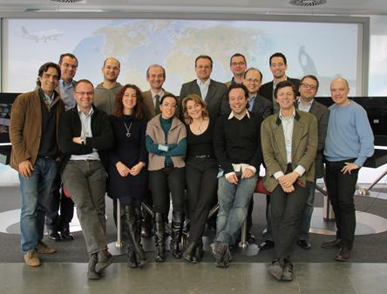
L4S – Learning for Security (IST- 225634): Serious games addressing soft skills development for crisis managers. FVA was responsible of interface design, software development, dissemination material design and media production.

Slide 25
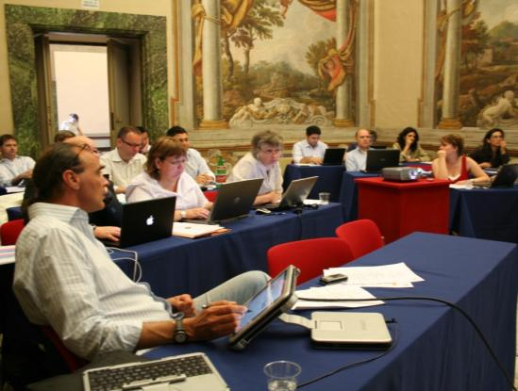
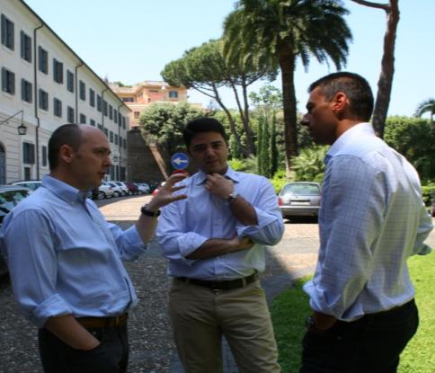
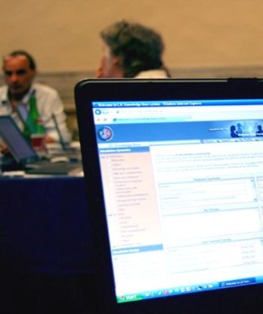
L2C – Learning to Collaborate (IST- 6° Framework – 027288). Serious games and learning experiences to improve collaboration in organizational contexts. FVA was responsible for the Knowledge Community design and programming and interface design for the Simulation Games.

Slide 26
Do you want to play?

Slide 27
Thank you!
Website: www.fvaweb.eu
Email: info@fvaweb.it

